Slide 1







Perth Machine Learning Group
@PerthMLGroup

Slide 2
Perth Machine Learning Group
www.fast.ai (Part 1, 2 & NLP)
forums.fast.ai
Part 1 course v4 to be released in July 2020

Slide 3

PMLG.org
www
GENERAL ADVICE WARNING
DISCLAIMER
All statements made by PMLG are made in good faith and we believe they are accurate and reliable. PMLG does not give any warranty as to the accuracy, reliability or completeness of information that is contained in its media, except in so far as any liability under statute cannot be excluded. PMLG, its directors, employees and their representatives do not accept any liability for any error or omission in any PMLG media, correspondence or events or for any resulting loss or damage suffered by the recipient or any other person. Unless otherwise specified, copyright of information provided on PMLG media are the property of PMLG.
The information provided on and through all PMLG media, correspondence and events is general in nature only and does not constitute personal advice. The information has been prepared without taking into account your personal objectives, situation or needs. Before acting on any information on this website you should consider the appropriateness of the information having regard to your objectives, situation and needs. Therefore, before you decide to act on any information, buy any product or keep or cancel a similar product that you already hold. Before making any decision, it is important for you to consider these matters and to seek appropriate technical, legal and other professional advice.

Slide 4






Thanks to our sponsors:
To win a 12-mth professional licence

Slide 5
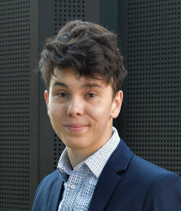

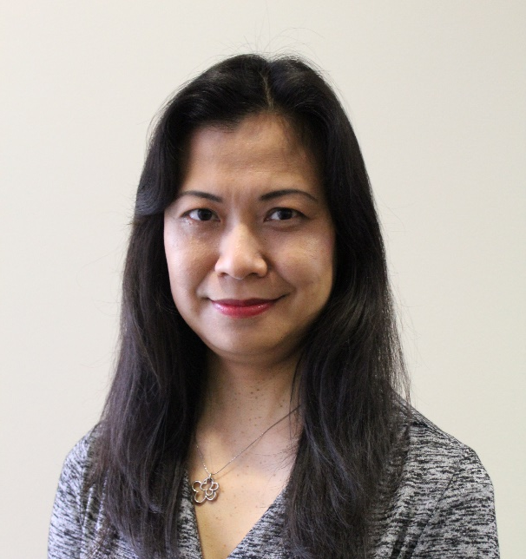
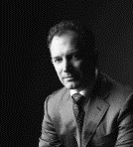
Mentors
www
Jack
Pooya
Sarada
Sean

Slide 6
Rundown
www
5.30 pm Workshop starts
5.40 pm Machine Learning Overview - Pooya
6.00 pm Image classification walkthrough - Jack
7.00 pm (ETA) 20 minutes break
7.20 pm Build your own image classifier - You
8.00 pm Deep Learning Application - Pooya
8.20 pm Next steps
Learning objective:
- hands on development of image classification model

Slide 7



Let us know in Zoom, if you are …
www
following along and complete the task.
just needing a bit of time. Please slow down and wait for me.
confusing and needing help. A mentor will help you in a breakout room.

Slide 8
Before we start,
www
Log into your destinated Google account
Main GitHub: github.com/pmlg/SheCodes20
Alternative GitHub:
github.com/slee5777/SheCodes20
github.com/jcmc00/SheCodes20
github.com/pooyad359/SheCodes20

Slide 9
www
Machine Learning Overview

Slide 10

Next Steps
Join forum.fast.ai and go through www.fast.ai courses
www
(v2 to released in July 2020)

Slide 11
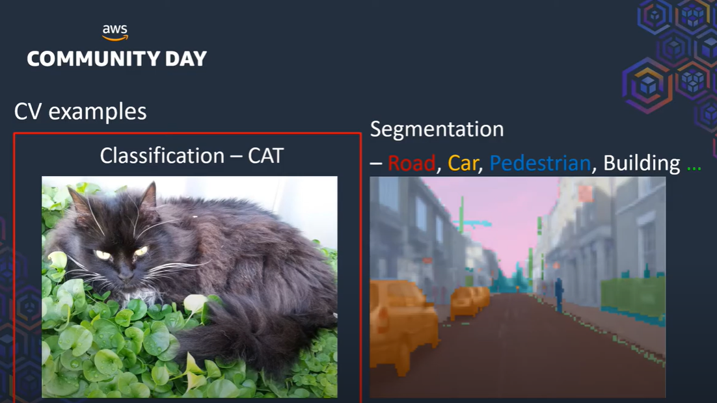
Next Steps
www
2. How to build your computer vision project from stretch?
https://youtu.be/pXvh1FcHjHg

Slide 12
Next Steps
3. Join and follow Perth Machine Learning Group
@PerthMLGroup
www

Slide 13
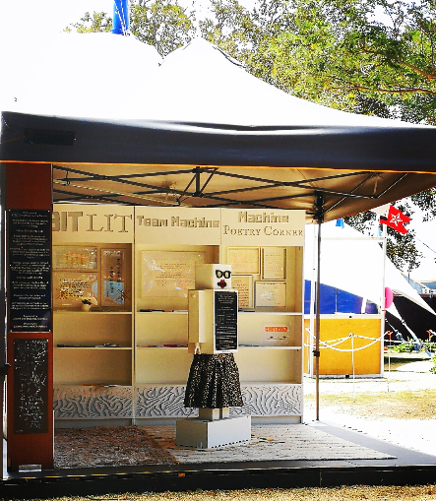
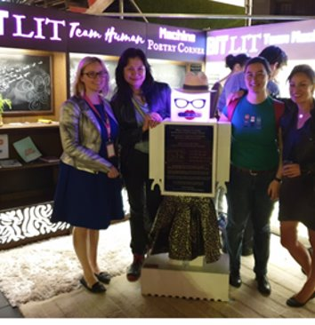
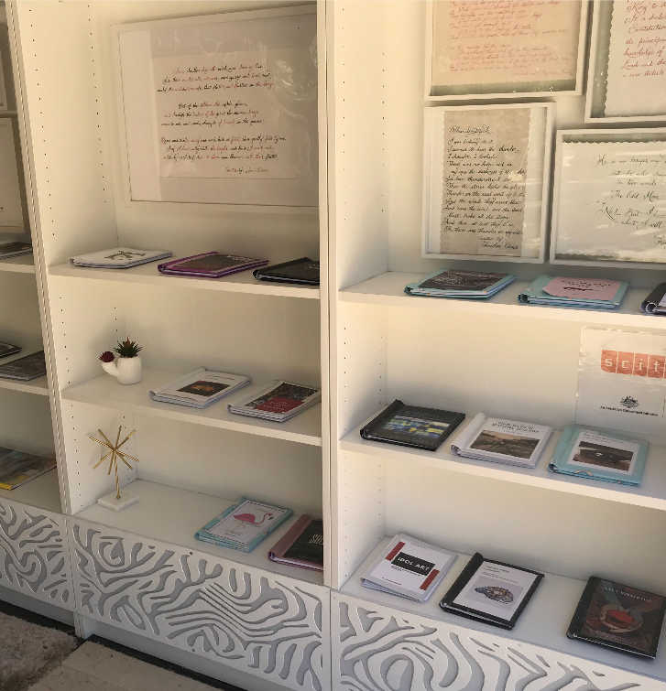
Fringe 2019: BitLit Machine Poetry Corner

Slide 14

